Slide 1
Empirical Analysis of
RL algorithms via Openai Gym env.
Donggyu, Sungwon, Yourim
Notes:
Welcome to our video on deep reinforcement learning algorithms!
We are team 16 동규 성원 유림

Slide 2
Table of contents
01
02
03
Objectives
Environments
Experiment
04
05
06
Challenges
Result
have Learned

Slide 3

Objectives
Analyze Algorithms
Gain insights
Try 3 different RL algorithms we learnt in class(DQN, A2C, PPO) to Atari games and OpenAI environment.
We seek to explore the strengths and limitations of each algorithm and gain insights in different environments.

Slide 4
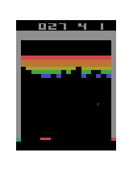
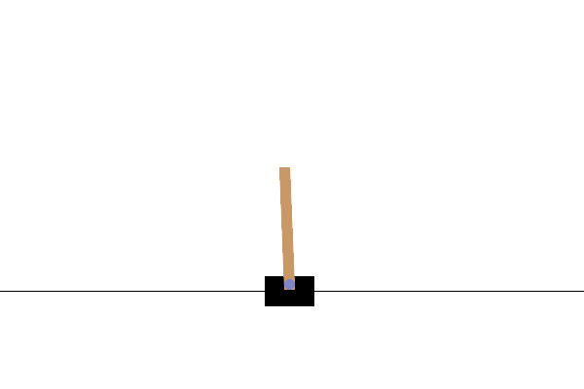
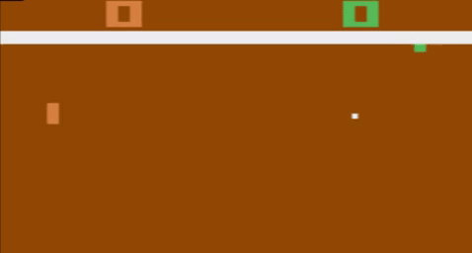
Environments
Atari - Pong
Atari - Breakout
Classic Control - Cart Pole
Atari games are arcade games published in 70~80s which are controlled by joysticks.
Classic controls are simple environment that state, action, rewards are neatly defined.
Both are supported by OpenAI Gym environment.

Slide 5
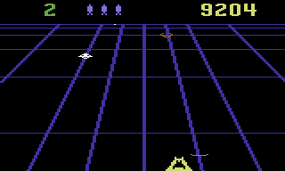
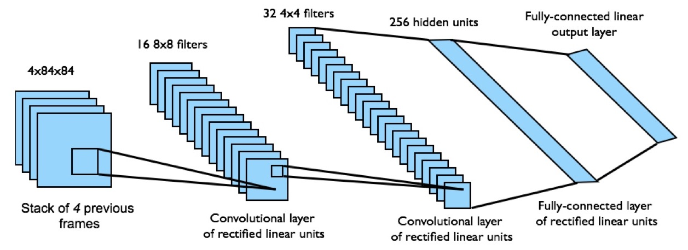
Experiment - Atari
DQN, A2C, PPO
RL algorithms
Atari game frames
Notes:
We experimented Atari on CNN

Slide 6
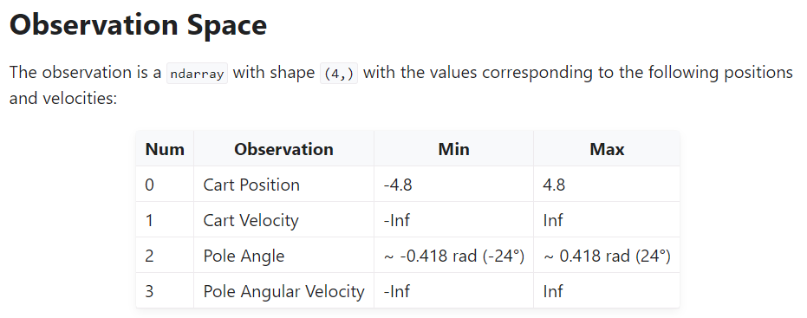
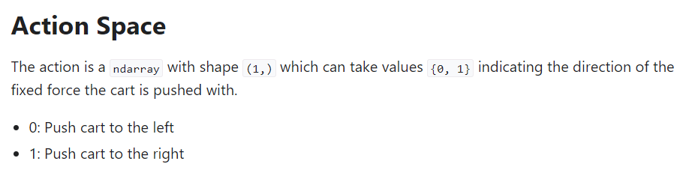
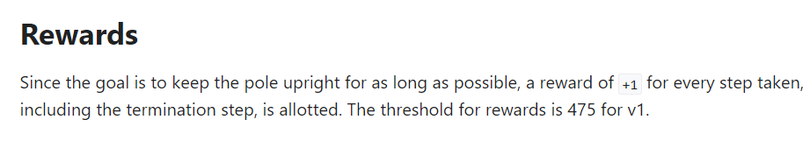
Experiment - Classic
Classic Environments
(Cart Pole)

Slide 7
Experiment
Atari | Categories | Classic | Type of Action
Beam Rider | Shooter | Cart Pole | Discrete
Breakout | Platform | Acrobot | Discrete
Enduro | Driving | MountainCar | Discrete
Space Invaders | Shooter | MountainCar Continuous | Continuous
Pong | Sports | Pendulum | Continuous
Qbert | Puzzle | All environments were trained in 5M frames. MountainCarContinuous and Pendulum trained with only A2C and PPO because of continuous action space.
Seaquest | Shooter & Platform
Notes:
There were diverse categories of games and tasks

Slide 8
Challenges
Unstable Convergence
Averaging results
Lack of resources
OKish in comparison
Implement Issues
Mostly solved
Some algorithms like A2C has large variance in final result and sometimes does not converge.
To extract result with uniformity, we averaged multiple result.
Because of lack of GPU, it is almost impossible to train like original paper (160M frames)
We trained with 5M frames, and it showed enough distinction between the result and characteristics of algorithms
Window/Mac, library (mainly Gym) version issues, Colab/local issues
With the help of StackOverflow, we could solved most of the problems.

Slide 9
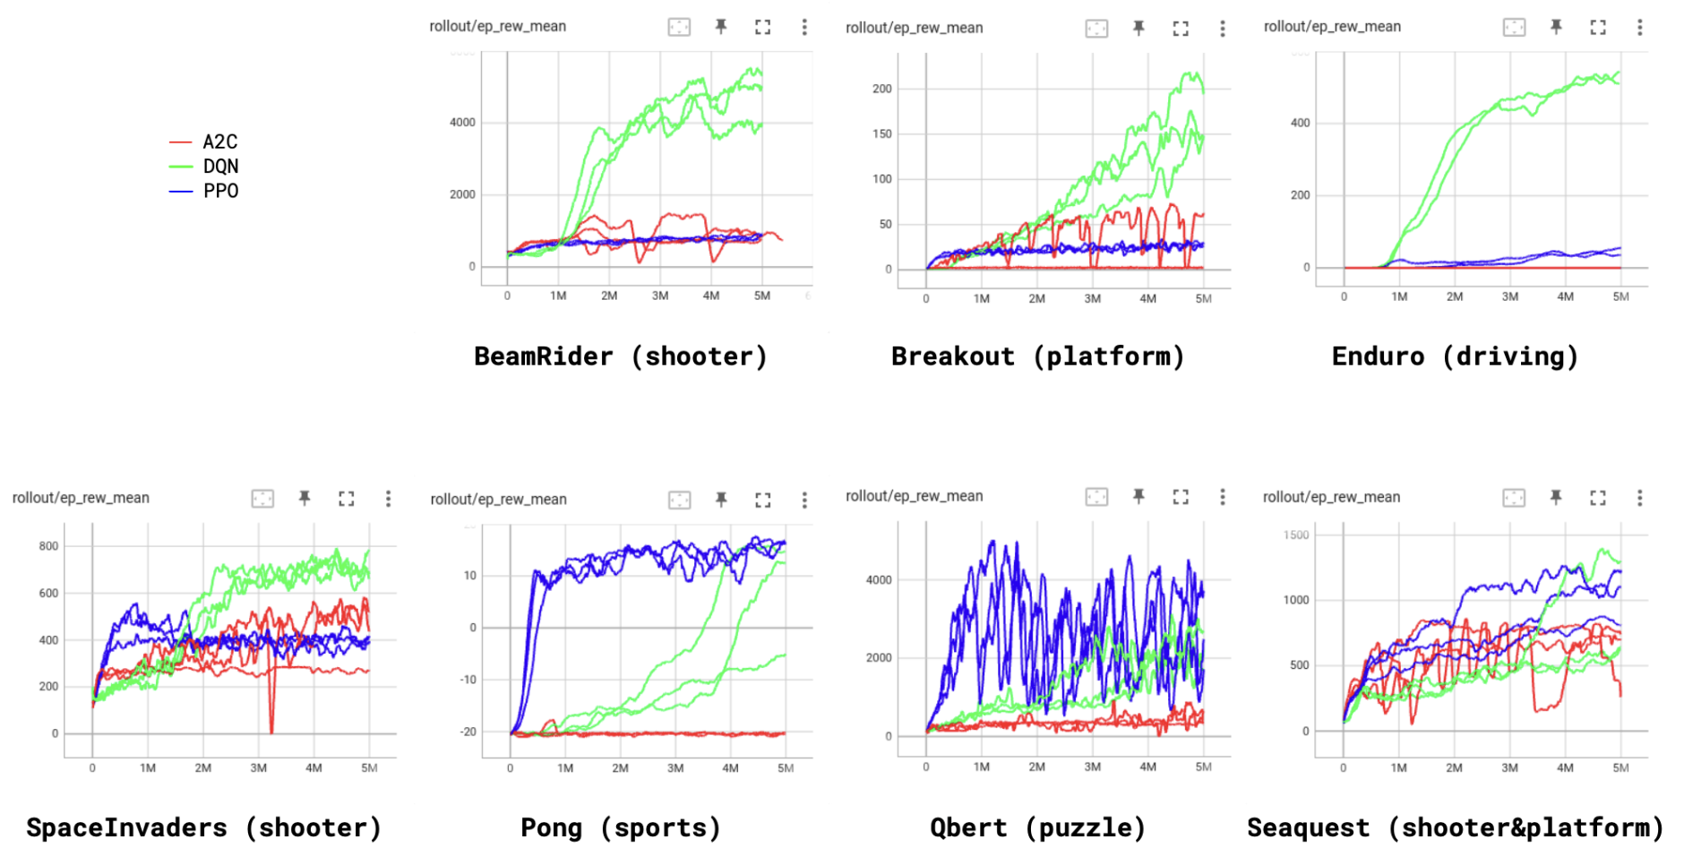
Results - Atari
4 stacked frames / 4 parallel environments / gradient clipping
Notes:
Figure shows the score (the sum of rewards in an episode) averaged over 100 episodes

Slide 10
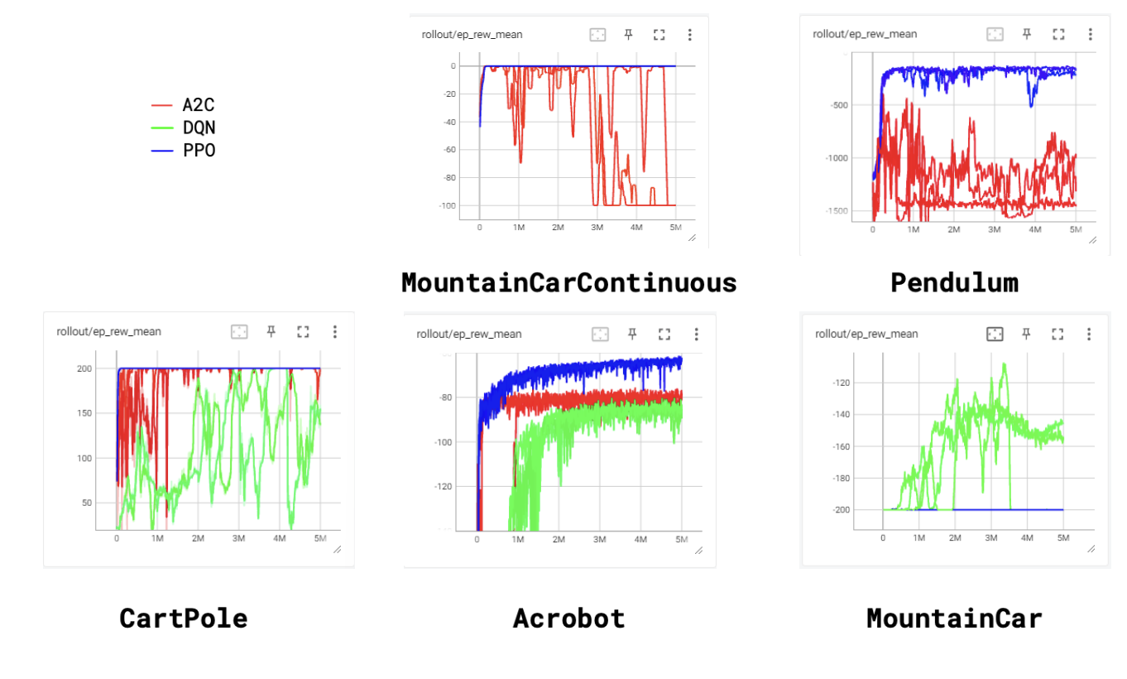
Results - Classic

Slide 11
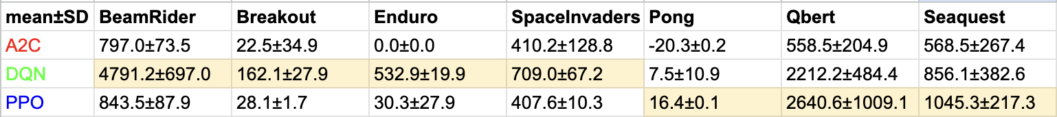
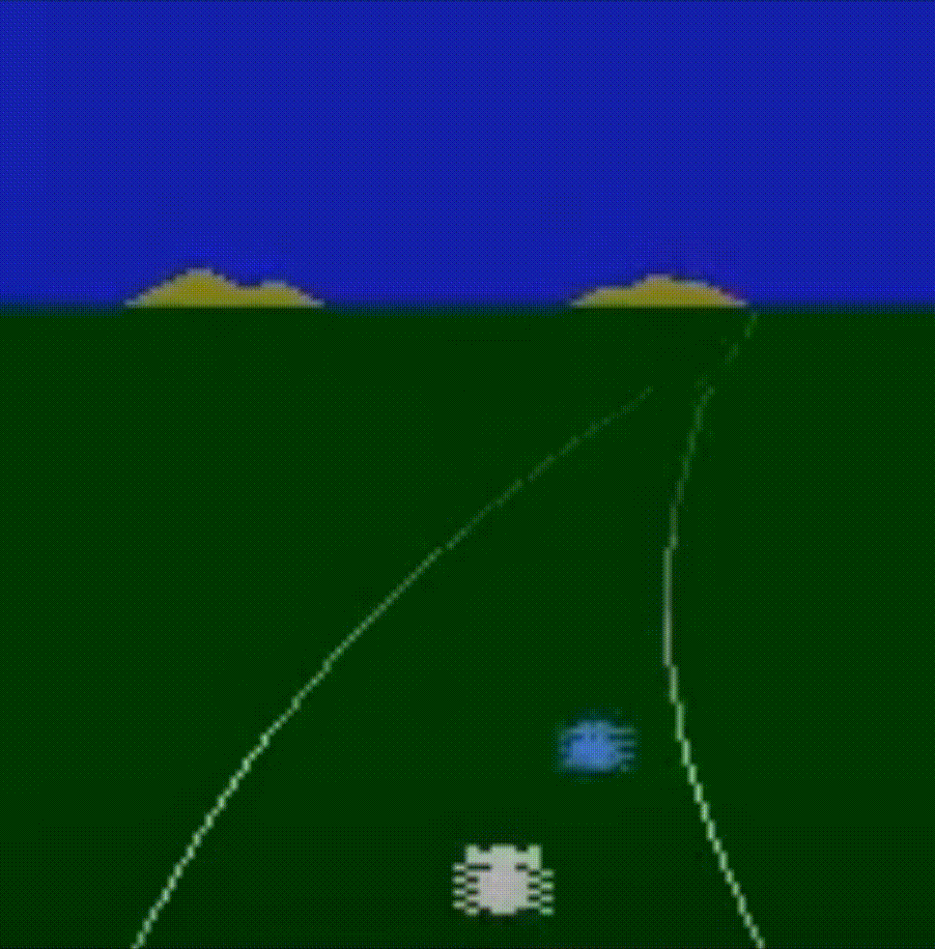
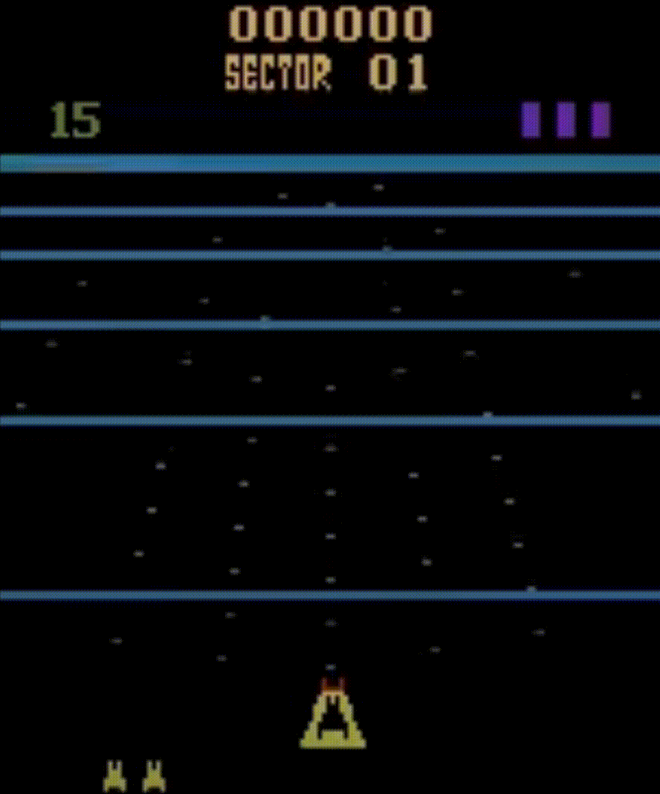
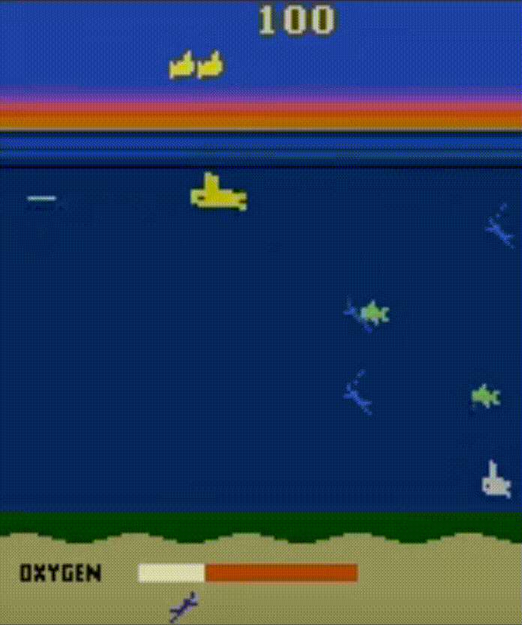
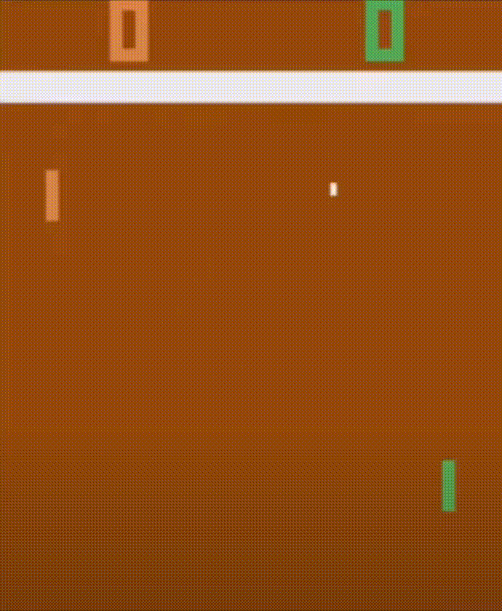
Discussion - Atari
DQN topped in 4 / PPO in 3 / A2C in 0 games
DQN performed better in games with more dynamic scenes.
PPO performed better in games with more static scenes.
DQN’s replay buffer makes it deal better with rare observations while on policy algorithms may underfit to rare observations.
Atari environments don’t require probabilistic policies unlike multi-agent environments where deterministic policies can be exploited by other agents (ex. rock-scissors-paper).
DQN PPO
Notes:
The table shows the final score

Slide 12
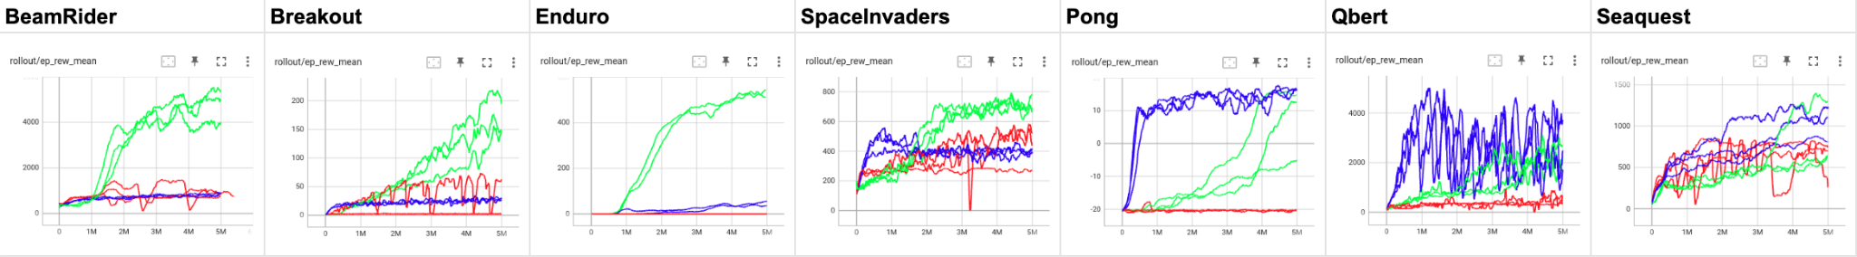
Discussion - Atari
Convergence in the early stages of training led to convergence to local optimum.
In many games, PPO quickly learned local optimal policy and converged while DQN kept improving and finally outperformed PPO.
Off-policy algorithms can better explore than on-policy algorithms.

Slide 13
Discussion - Atari
Instability of A2C
Possible explanations to why A2C failed to learn :
2 sources of error (V and pi)
Clipping changes in policy as in PPO worked better than clipping gradient itself.
A2C had large fluctuations in training curve.
More sensitive to hyperparameters and seeds.

Slide 14
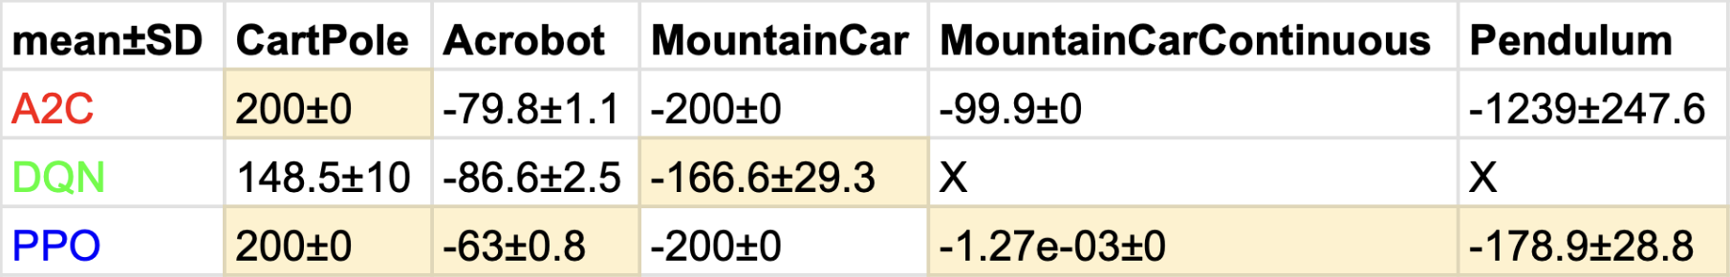
Discussion - Classic
In classical games, PPO won 4 times, A2C won 1 time, DQN won 1 time.
Most of the characteristics in algorithms were same as shown in Atari game.
There was no particular difference between discrete/continuous action spaces.
In MountainCar and MountainCarContinuous, PPO and A2C fell into local optimum.

Slide 15
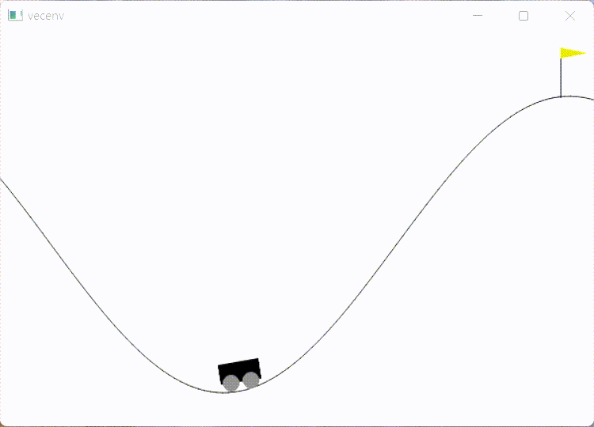
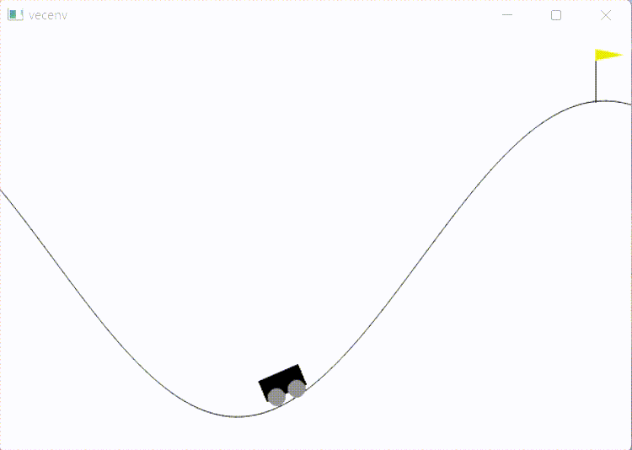
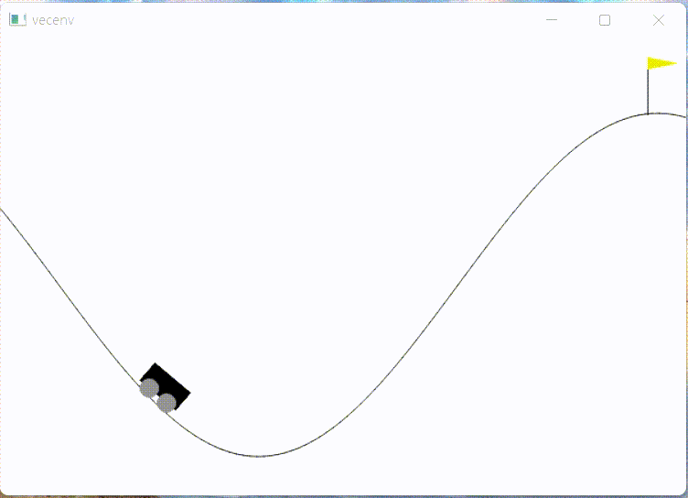
Discussion - Classic
A2C
PPO
DQN
In MountainCar - v0 environment, the goal is to reach the flag which gives reward +100.
Each timestep gives -1 reward.
A2C and PPO moves near ground while DQN aggressively explore the environment.

Slide 16
Limitations
Lack of hyperparameter search
Due to time limit, hyperparameters that were known to be working well in many environments were used. However, there could be other sets of hyperparameters that might work better in certain situations.
Limited statistical significance
Some games were more complex than others, requiring more training steps before convergence. Although we could see patterns in training graphs, more data is needed for statistical significance.

Slide 17
What we have learned
There is no omnipotent RL algorithm performing well in all environments.
Each algorithm has its strengths and weaknesses; their performance can vary based on the complexity and dynamics of the environment.
Algorithms differ not only in final performance, but also robustness to hyperparameters and randomness.
We must consider many different aspects of algorithms like performance, robustness, sample efficiency to choose the right algorithm for the situation.

Slide 18
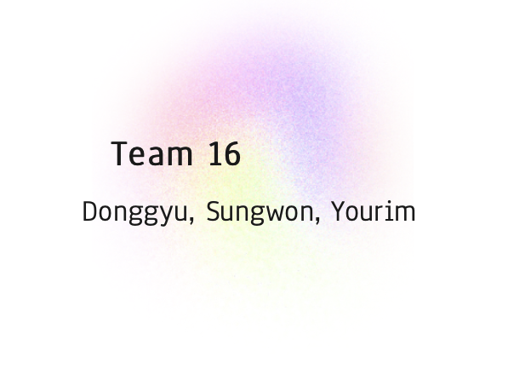
Thank you!
We appreciate your attention and your feedback.

